Slide 1
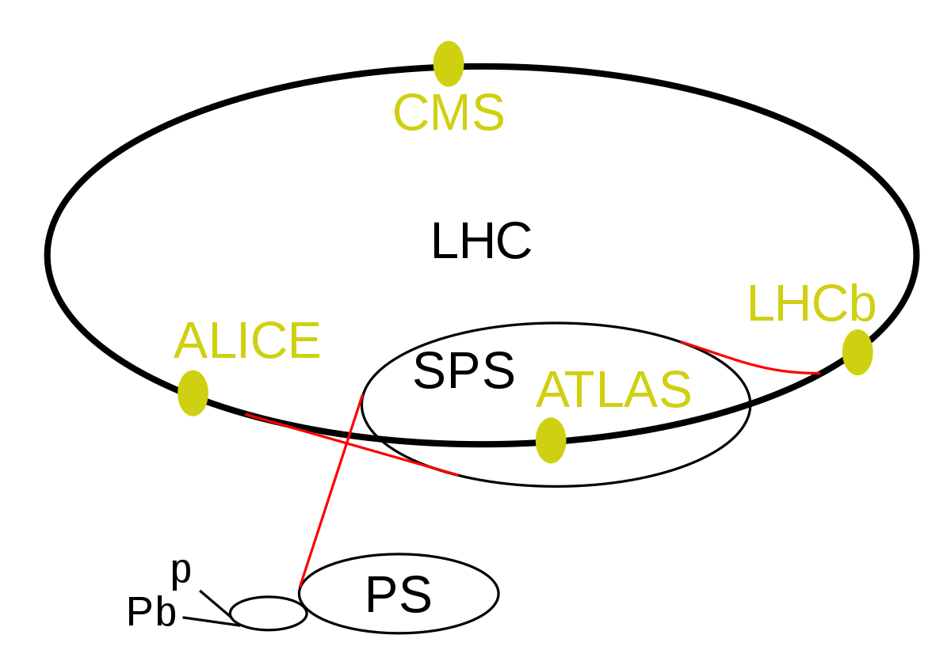

The Search for Axion Like Particles (ALPs) in B Meson Decays at the LHCb
Subrahmanya “Sai” Pemmaraju (supervised by Prof. Ulrik Egede) 06/12/2022
Notes:
Introduce self + supervisor, subject of talk, mention of physics beyond the SM,
Emphasise use of natural units for energies, masses and momenta measured
- Mention Large Hadron Collider b detector

Slide 2
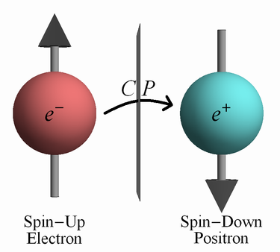
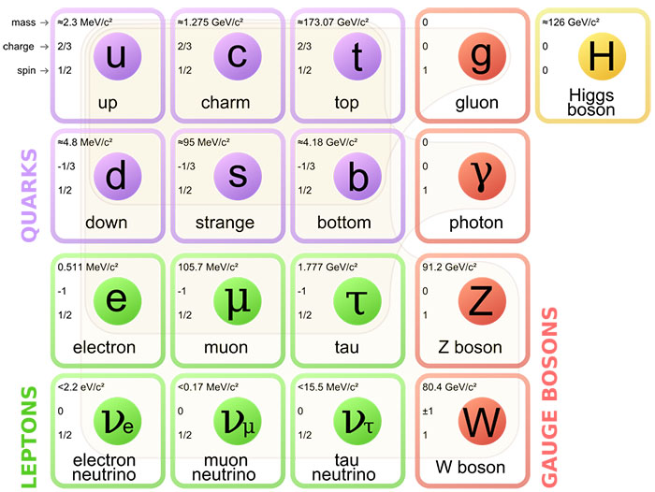
Background and Motivation
CP symmetry is preserved in EM interactions but violated by weak interactions (Cronin & Fitch, 1964)
CP violation is not observed experimentally in the strong force, despite being theoretically allowed (Strong CP Problem). Significant limitation of the Standard Model
Notes:
CP symmetry = preserved in EM interactions and violated in weak interactions (e.g. Cronin and Fitch’s study of neutral kaon decay in 1964)
CP violation is not observed experimentally in the strong force, despite being theoretically allowed (Strong CP problem). Significant limitation of the Standard Model

Slide 3
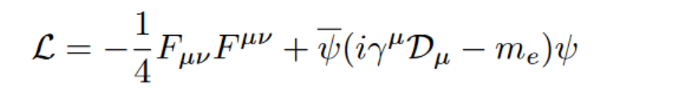

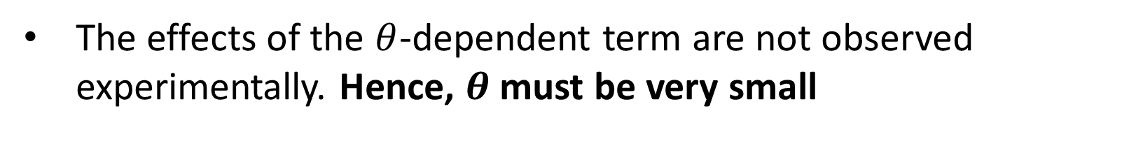
The Strong CP Problem
CP violation is theoretically permitted in the strong force (QCD) but there is no experimental evidence of this
QED Lagrangian (electromagnetism):
T
Consider the QCD (strong) Lagrangian written in the following form:
The effects of the $θ$-dependent term are not observed experimentally. Hence, $θ$ must be very small
D.Tong, Lectures in Quantum Field Theory: https://www.damtp.cam.ac.uk/user/tong/qft/one.pdf
C.T. Chan, On the Symmetry Constraints of CP Violations in QCD: https://arxiv.org/pdf/hep-ph/9704427.pdf
Notes:
QED = CP symmetry is preserved. Included the Lagrangian for comparison purposes
Effects of theta term are not observed in QCD. Hence, one concludes that $θ$ must be very small

Slide 4
The Strong CP Problem
CP violation is theoretically permitted in the strong force (QCD) but there is no experimental evidence of this
QED Lagrangian (electromagnetism):
T
Consider the QCD (strong) Lagrangian written in the following form:
The effects of the $θ$-dependent term are not observed experimentally. Hence, $θ$ must be very small
D.Tong, Lectures in Quantum Field Theory: https://www.damtp.cam.ac.uk/user/tong/qft/one.pdf
C.T. Chan, On the Symmetry Constraints of CP Violations in QCD: https://arxiv.org/pdf/hep-ph/9704427.pdf
Notes:
QED = CP symmetry is preserved. Included the Lagrangian for comparison purposes
Effects of theta term are not observed in QCD. Hence, one concludes that $θ$ must be very small

Slide 5

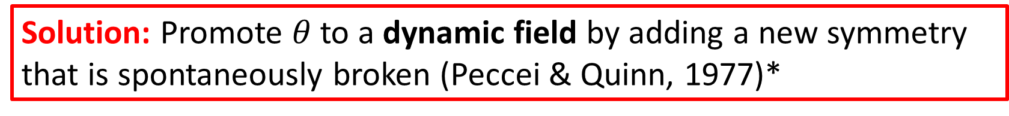
The Strong CP Problem and its Resolution
Experimental measurements of neutron EDM => $\left|θ\right|<{10}^{−10}$
Spontaneous breaking of this PQ symmetry introduces a new pseudoscalar (spin 0 and odd parity) particle known as the (QCD) axion. (No experimental evidence of this)
Solution: Promote $θ$to a dynamic field by adding a new symmetry that is spontaneously broken (Peccei & Quinn, 1977)*
*D.Tong, Lectures in Quantum Field Theory: https://www.damtp.cam.ac.uk/user/tong/qft/
Notes:
Absence of experimental evidence of CP violation => angular terms are close to 0
Experimental measurements of neutron EDM help constrain the value of these terms to below 10^-10 (fine tuning problem)
Can promote theta to a dynamic field by introducing a new symmetry that is spontaneously broken (Peccei and Quinn, 1977)
Theta is a field => it has a potential and excitations in this potential will produce new particles
New particle = pseudoscalar (spin 0 and odd parity) as known as the axion (NO EXPERIMENTAL EVIDENCE OF THIS, AND THIS HAS BEEN RULED OUT)
Axion will sit at the bottom of its field potential, thereby leading to CP violating parameters being equal to 0 w/o fine tuning

Slide 6
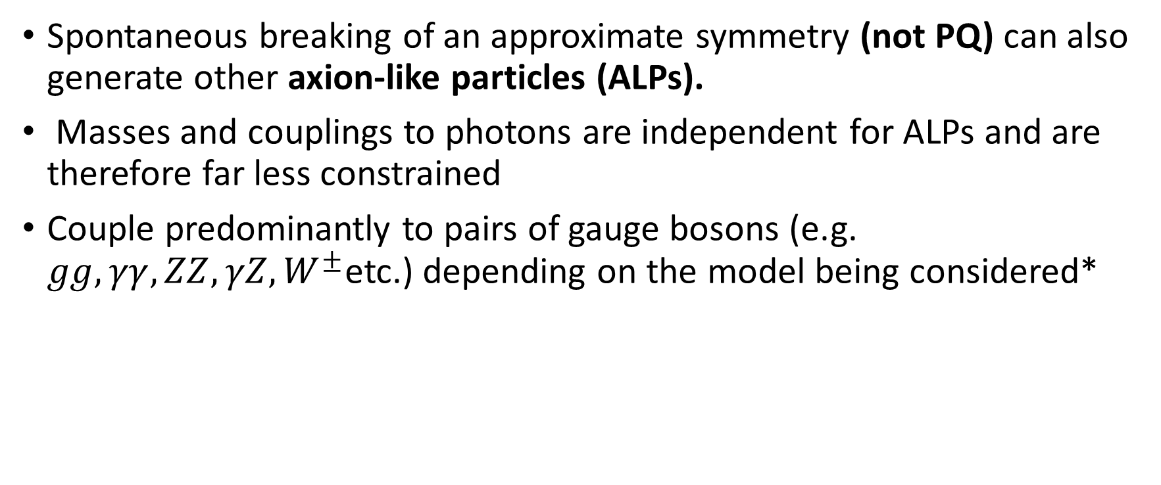
Axion Like Particles (ALPs)
Spontaneous breaking of an approximate symmetry (not PQ) can also generate other axion-like particles (ALPs).
Masses and couplings to photons are independent for ALPs and are therefore far less constrained
Couple predominantly to pairs of gauge bosons (e.g. $gg, γγ, ZZ, γZ, W^{±}$etc.) depending on the model being considered*
*Ringwald (2014) Axions and Axion-Like Particles: https://arxiv.org/pdf/1407.0546.pdf
** Isern et al. (2018) Axions and the Cooling of White Dwarf Stars https://arxiv.org/pdf/0806.2807.pdf
Notes:
SB of approximate symmetry (NOT PQ symmetry) can generate ALPs (they are similar to axions)
Masses and couplings to photons are independent for ALPs, whereas they vary inversely in the case of axions
Couple predominantly to pairs of gauge bosons, depending on model being considered
Hypothetical, feebly interacting pcle => Candidate for DM
Helps solve various astrophysical puzzles (e.g. anomalies in energy loss of white dwarf stars)**

Slide 7
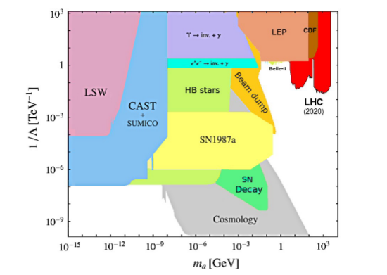
Experimental Searches for Axions and ALPs
Spin-selection rules => light pseudoscalars naturally couple to photons
Search strategies generally exploit the (inverse) Primakoff effect
Notable search strategies (excluding collider searches):
LSW (Light Shining Through Walls) Experiments
Any Light Particles Search (ALPS I)
ALPS II
Helioscope Searches
International Axion Observatory (IAXO)
CERN Axion Space Telescope (CAST)
Haloscope Searches
Axion Dark Matter Experiment (ADMX)
PIXIE
PRISM CMB
Source: A. Ringwald. Axions and axion-like particles, 2014.
Notes:
Spin selection rules => Axions and ALPs naturally couple to photons
Search strategies generally exploit the (inverse) Primakoff effect, wherein axions are converted into pairs of photons and vice versa
Notable search strategies include:
LSW: Send laser photons along strong B field and allow for conversion to ALPs on one side of a wall. ALPs might reconvert into photons on the other side of the wall
Helioscope: Detecting solar ALPs which convert into photons in presence of strong B-field
Haloscope: Direct search for galactic halo DM axions and ALPs in the lab
Plot: constraints imposed on the mass and coupling strength to photons of ALPs by the different search strategies.

Slide 8
Strategy: Search for ALPs at Colliders
0. Set limit on branching fraction of decay of interest using Monte Carlo (MC) simulated data to determine if analysis is viable/worth pursuing
Event selection (i.e. impose constraints on kinematic and shape variables to distinguish signal from background within MC simulated data)
Check optimised event selection against a real data sample to verify that MC simulation models the data
Perform a fit to extract the signal yield
Estimate systematic errors
Notes:
Analysis steps
0. Set limit on branching fraction of decay of interest using MC simulated data to determine if analysis is viable/worth pursuing
Event selection (i.e. impose constraints on kinematic and shape variables to distinguish signal from background within MC simulated data)
Check optimised event selection against a real data sample to verify that MC simulation models the data
Perform a fit to extract the signal yield
Estimate systematic errors

Slide 9
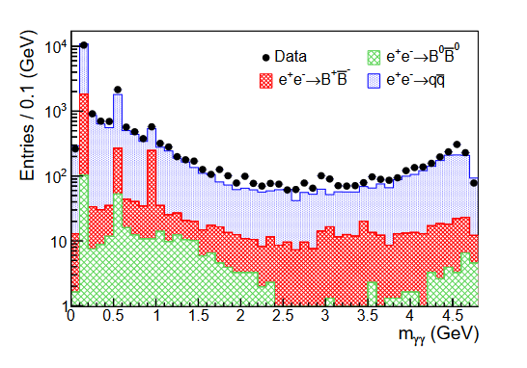

Strategy: Search for ALPs at LHCb
Seek diphoton resonance structures
Promising decay channel for search: $B^{0}→K^{∗0}a_{0}, a_{0}→γγ$
ALPs produced in $B$-meson decays have a maximal mass of
$$m_{a_{0}}=m_{B^{0}}−m_{K^{∗}}=5279.26−493.68 MeV=4785.58 MeV$$
The BABAR Collaboration: Search for Axion Like Particles in B Meson Decays: https://arxiv.org/pdf/2111.01800.pdf
Notes:
Seek diphoton resonance structures (contributions from pi0, eta and eta’ in the purple regions in the graph). Otherwise nothing else is of interest
Max mass of ALPs being produced here is 4785.58 MeV (since rest mass of B0 is 5 GeV)
Explain plot in further detail (different coloured regions = different meson-anti-meson pairs produced from e+ e- collisions)

Slide 10
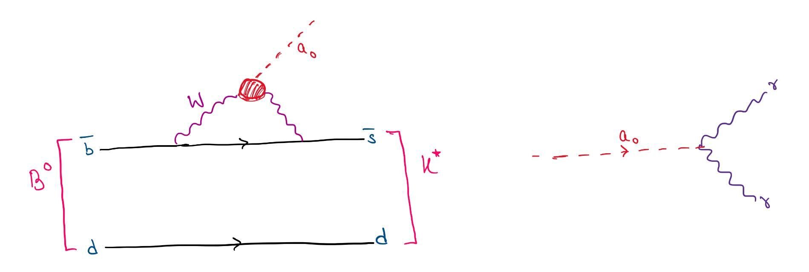


The $B^{0}→K^{∗0}a_{0}, a_{0}→γγ$ Decay
Consider model where ALP couples to weak gauge bosons $W^{±}$, and gives rise to observable signatures (zero coupling with gluons)
Flavour Changing Neutral Current (FCNC) process $(\overline{b}→\overline{s}$ quark transition)
Electroweak penguin decay that proceeds at one-loop level
(R) Image Source: https://cerncourier.com/a/chasing-new-physics-with-electroweak-penguins/
Source: https://arxiv.org/abs/1611.09355
Notes:
Promising decay channel to search for ALPs at LHCb is $B→K^{∗0}a_{0}, a_{0}→γγ$, since this gives rise to observable signatures and is easier to analyse in the LHCb
Flavour Changing Neutral Current Decay
Also an electroweak penguin decay (diagram looks like a penguin)

Slide 11
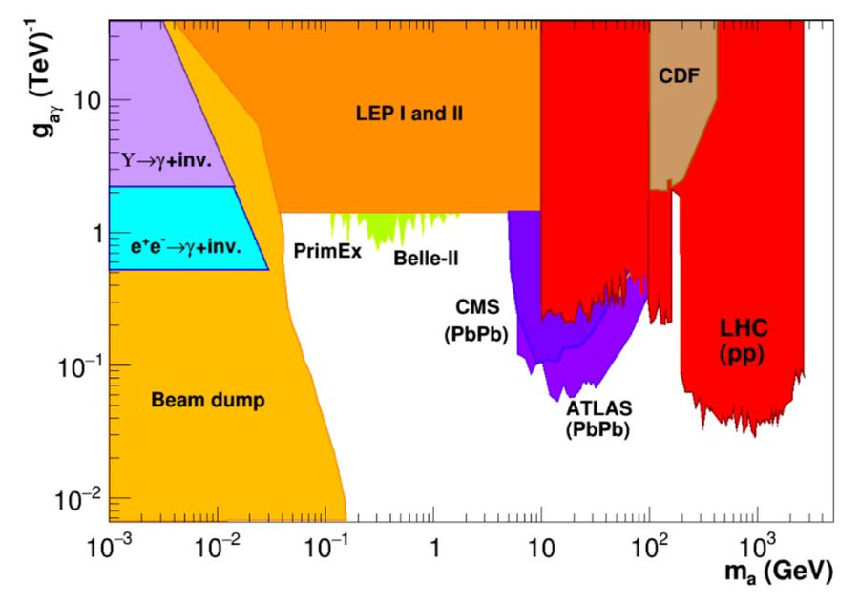
My Analysis (to date)
Setting limit on branching fraction of decay process to determine if analysis is viable/worth pursuing (i.e. Step 0 on Slide 6 => preliminary stages)
Relating the branching ratio to the mass and coupling strength of the ALP to photons
Comparing the limits set on the mass and coupling strength to those in existing literature
http://arxiv.org/abs/2102.08971
Notes:
Setting limit on branching fraction of decay process to determine if analysis is viable/worth pursuing (i.e. Step 0 on previous slide => preliminary stages)
Relating the branching ratio to the mass and coupling strength of the ALP to photons
Comparing the limits set on the mass and coupling strength to those in existing literature (LH plot: we are trying to exclude more of the white region if not find the ALP itself). ATLAS has PbPb collisions for the same and has set different limits to what we can.
LHCb => Can try and exclude regions in the low-mass (below 5 GeV) range

Slide 12
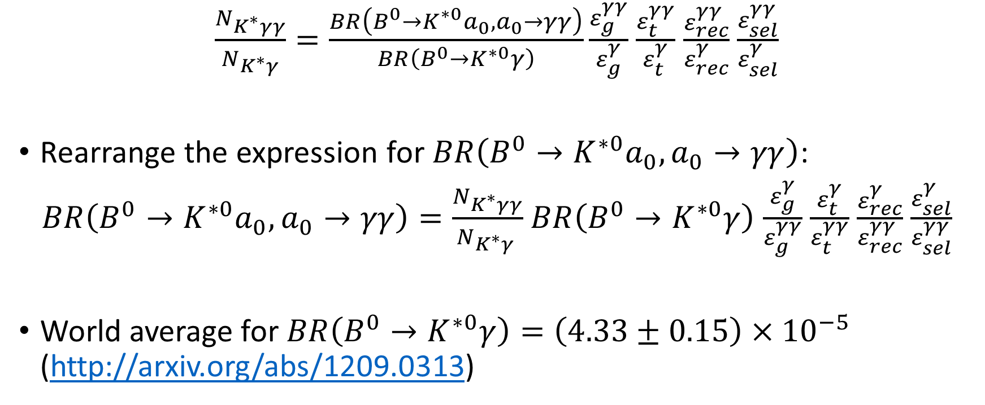
Electromagnetic Trigger Efficiency Study
$\frac{N_{K^{∗}γγ}}{N_{K^{∗}γ}}=\frac{BR\left(B^{0}→K^{∗0}a_{0}, a_{0}→γγ\right)}{BR\left(B^{0}→K^{∗0}γ\right)}\frac{ε_{g}^{γγ}}{ε_{g}^{γ}}$ $\frac{ε_{t}^{γγ}}{ε_{t}^{γ}}$ $\frac{ε_{rec}^{γγ}}{ε_{rec}^{γ}}$ $\frac{ε_{sel}^{γγ}}{ε_{sel}^{γ}}$
Rearrange the expression for $BR\left(B^{0}→K^{∗0}a_{0}, a_{0}→γγ\right)$:
$BR\left(B^{0}→K^{∗0}a_{0}, a_{0}→γγ\right)=\frac{N_{K^{∗}γγ}}{N_{K^{∗}γ }}$ $BR\left(B^{0}→K^{∗0}γ\right)$ $\frac{ε_{g}^{γ}}{ε_{g}^{γγ}}$ $\frac{ε_{t}^{γ}}{ε_{t}^{γγ}}$ $\frac{ε_{rec}^{γ}}{ε_{rec}^{γγ}}$ $\frac{ε_{sel}^{γ}}{ε_{sel}^{γγ}}$
World average for $BR\left(B^{0}→K^{∗0}γ\right)=\left(4.33±0.15\right)×{10}^{−5}$ (http://arxiv.org/abs/1209.0313)

Slide 13
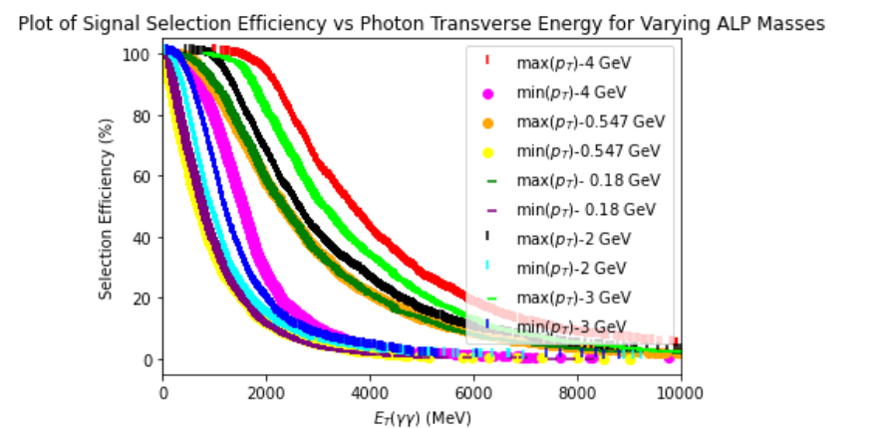
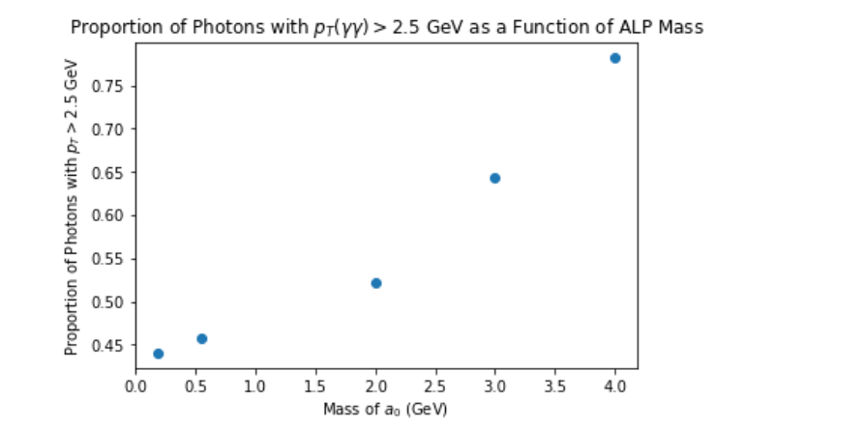

Electromagnetic Trigger Study (contd.)
Seek to determine how $ε^{γγ}$ varies as a function of ALP mass

Slide 14
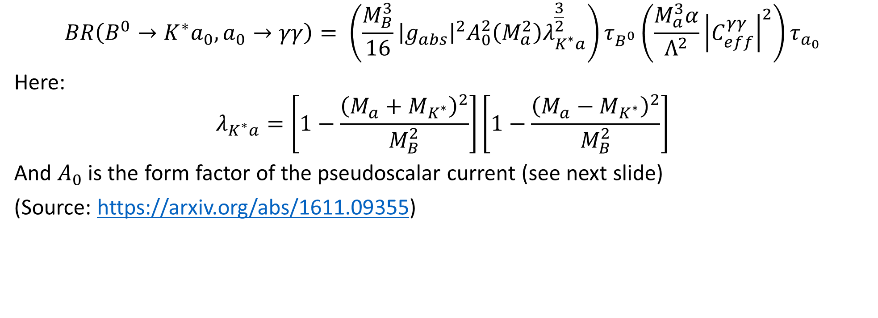
Link Between Branching Ratio, Coupling Strength and ALP Mass
$$BR\left(B^{0}→K^{∗}a_{0}, a_{0}→γγ\right)= \left(\frac{M_{B}^{3}}{16}{\left|g_{abs}\right|}^{2}A_{0}^{2}\left(M_{a}^{2}\right)λ_{K^{∗}a}^{\frac{3}{2}}\right)τ_{B^{0}}\left(\frac{M_{a}^{3}α}{Λ^{2}}{\left|C_{eff}^{γγ}\right|}^{2}\right)τ_{a_{0}}$$
Here:
$$λ_{K^{∗}a}=\left[1−\frac{{\left(M_{a}+M_{K^{∗}}\right)}^{2}}{M_{B}^{2}}\right]\left[1−\frac{{\left(M_{a}−M_{K^{∗}}\right)}^{2}}{M_{B}^{2}}\right]$$
And $A_{0}$ is the form factor of the pseudoscalar current (see next slide)
(Source: https://arxiv.org/abs/1611.09355)
Notes:
Deduced a mathematical relationship between the branching ratio, coupling strength, and ALP mass

Slide 15
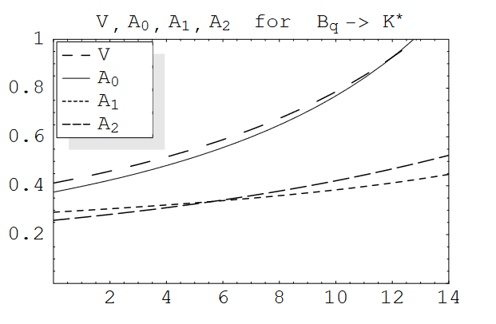
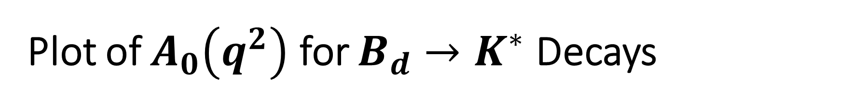
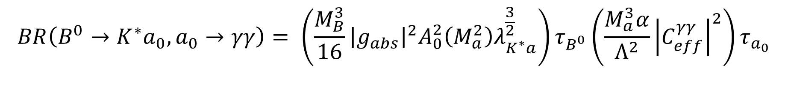
Plot of $A_{0}\left(q^{2}\right)$ for $B_{d}→K^{∗}$ Decays
$$BR\left(B^{0}→K^{∗}a_{0}, a_{0}→γγ\right)= \left(\frac{M_{B}^{3}}{16}{\left|g_{abs}\right|}^{2}A_{0}^{2}\left(M_{a}^{2}\right)λ_{K^{∗}a}^{\frac{3}{2}}\right)τ_{B^{0}}\left(\frac{M_{a}^{3}α}{Λ^{2}}{\left|C_{eff}^{γγ}\right|}^{2}\right)τ_{a_{0}}$$
Source: https://arxiv.org/pdf/hep-ph/0412079.pdf

Slide 16
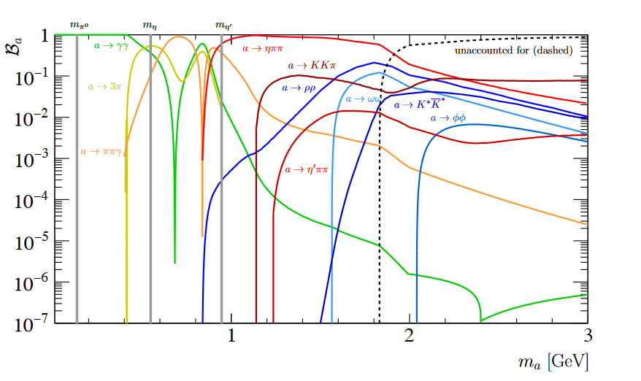
Plot of ALP Branching Fraction vs ALP Mass
https://journals.aps.org/prl/supplemental/10.1103/PhysRevLett.123.031803/supplemental.pdf
Notes:
Have to be aware of BR of other decay modes of ALPs (only considering decay for two photons in initial analysis)
Light green line is the decay mode of ALP of interest at LHCb

Slide 17
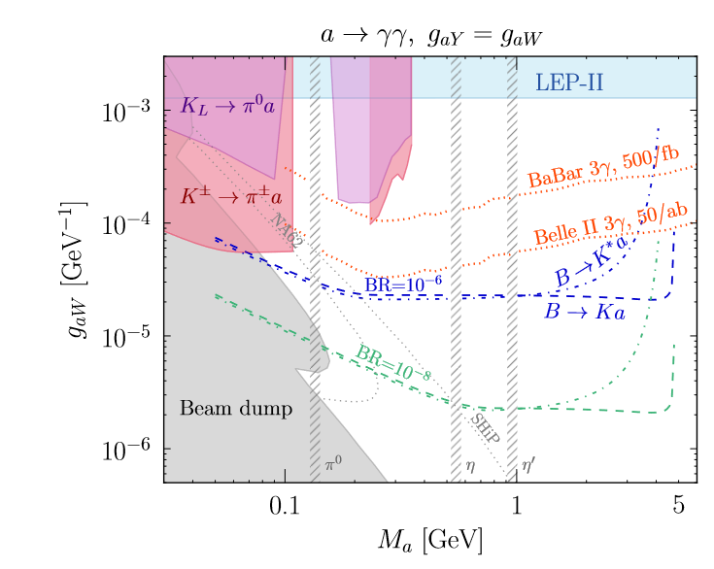
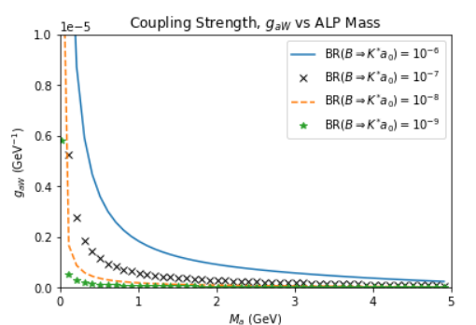
Coupling Strength vs ALP Mass (fixed Branching Ratio)
Notes:
- Plot of the Coupling strength of ALP to the W boson as a function of the ALP mass (at a fixed branching ratio)
Deduced an upper limit on BR at which our analysis is viable (10^-7)

Slide 18
Summary of Mass and Coupling Constraints
Notes:
Left hand side plot = collider constraints
RHS plot = all experimental constraints. Far right = region probed by colliders

Slide 19
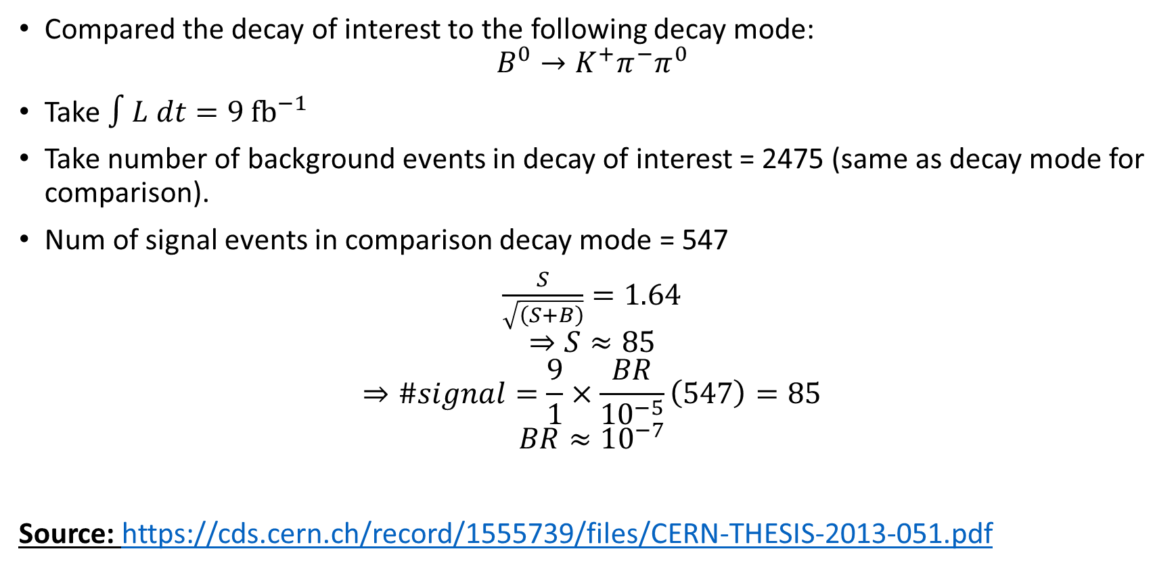
Addendum: Upper Limit on Branching Ratio
Compared the decay of interest to the following decay mode:
$$B^{0}→K^{+}π^{−}π^{0}$$
Take $∫L dt=9 {fb}^{−1}$
Take number of background events in decay of interest = 2475 (same as decay mode for comparison).
Num of signal events in comparison decay mode = 547
$\frac{S}{\sqrt{\left(S+B\right)}}=1.64$
$$⇒S≈85$$
$$⇒\#signal=\frac{9}{1}×\frac{BR}{10^{−5}}\left(547\right)=85$$
$$BR≈10^{−7}$$
Source: https://cds.cern.ch/record/1555739/files/CERN-THESIS-2013-051.pdf
Notes:
- Decay mode has a clear signal at $4×{10}^{−5}$ with 547 signal events and 2475 background events

